Slide 1


Il Console Onorario Thomas Botzios e la
Dott. ssa Marina Lenza, Director of Education Office del Consolato Generale d’Italia a Chicago invitano
Ridgewood High School
&
Istituto Superiore Carlo Dell’Acqua
alla presentazione del
Cross Cultural Exchange Program
Meeting 10 maggio 2022
10,00 Chicago / 17,00 Milano

Slide 2
Partecipanti /
Partecipanti:
Console Generale d’Italia Thomas Botzios
Dott. Marina Lenza, Director of Education Office
Dott. Laura Landonio, Principal CDA
Dott. Gina Castellano, Principal RHS
Prof. Vittoria Zingaro, docente CDA
Prof. Adriana Gallo, docente CDA
Prof. Dolores Pigoni-Miller, docente RHS
Prof. Gianna Gianfortone, docente RHS
Students:
Angela Borek, RHS
Giorgia Ornago, 4B RIM CDA Ivan Gregorace, 4BTUR CDA

Slide 3
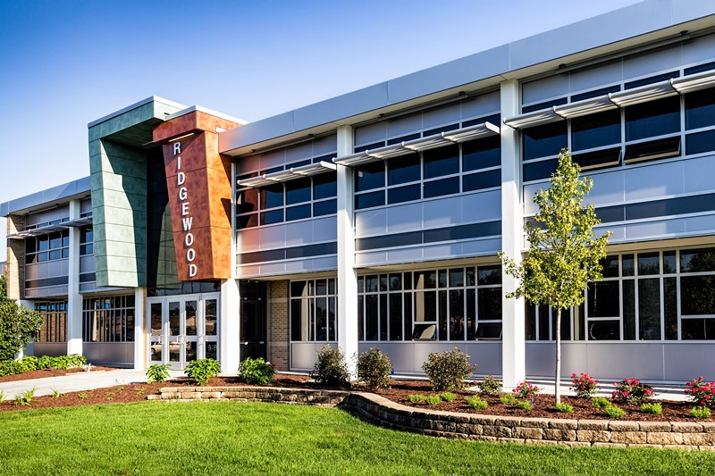
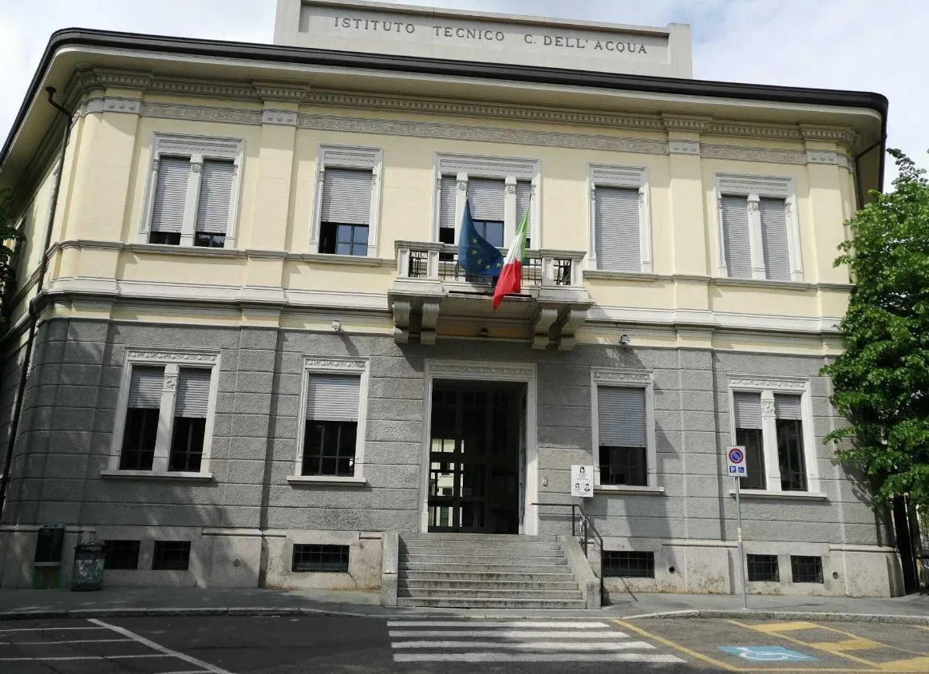


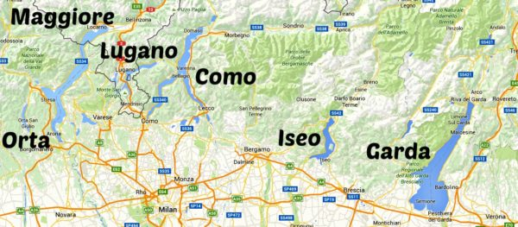
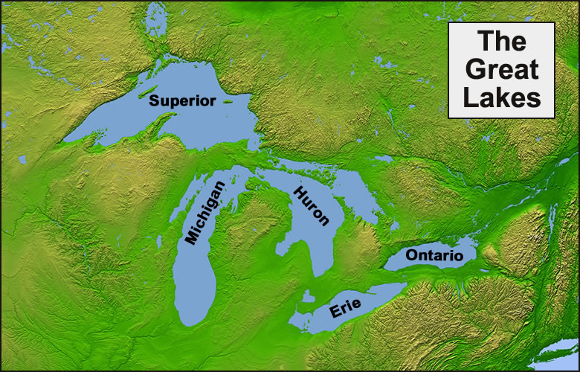

Slide 4
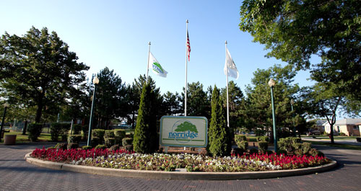
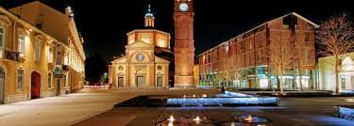
RHS and CDA commonalities
Come siamo simili?
Size / Grandezza
a. School / Scuola
B. Town / Paese
Location / Ubicazione
a. Great Lakes region / Regione dei laghi
b. To Chicago / A Milano
Shared interest in international collaboration / Desiderio di una collaborazione internazionale

Slide 5
Mission and Vision of Exchange Project
MISSION
Reinforce and expand students’ knowledge of their partners’ country and culture through email exchanges, video calls, and videos
Broaden students’ personal perspectives
Increase students’ target language skills
Encourage students to form relationships with their partners.

Slide 6
VISION
To strenghten students’ awareness of the international dimension
To implement a true cultural exchange in which students visit the partner school to collaborate on a project, shadow classes, and immerse themselves in local culture.
Diversity as a personal enrichment and growth

Slide 7
Project overview….
Creation of MOU (in English and Italian)
2 RHS and 2 CDA classes
2 Plenary Sessions
a. Q & A on culture (January)
b. Cultural Comparisons presentation (April)
Monthly Email Exchange Plan, videocalls, social media
Two projects:
Cultural Comparison / Youth Language
Paragone Culturale / Linguaggio dei Giovani

Slide 8
3. Monthly Email, videocall Exchange Themes and Format:
November Chi sono? (Who am I?)
December Un giorno tipico nella mia scuola
(A typical school day)
January Come trascorro le feste?
(Holidays)
February Pop Culture
March / April La mia città e Milano/Chicago
(My hometown and Milan/Chicago)
May Il cibo (Food)

Slide 9
4. My school video
5. My City Video
6. Cultural comparison project
7. I diversi registri linguistici della lingua italiana usati dai giovani (Youth Language) Videos and Lessons

Slide 10
What we have learned…
We have learned a lot about Ialian and American culture:
- school life
- free time
- the Italian cities
- holidays
- fashion
- sports
- food . . .

Slide 11
Future Plans
XXII Settimana della Lingua Italiana nel mondo – L’Italiano e i Giovani : Come, scusa? Non ti follow. Contest
Steam Project with Art
PBL assignment with English
Formative training enterprise
5. Milan/Chicago: eco-cultural tours
6. Eco sustainability in Northern Italy Lake District and in the American Great Lakes
7. What food is Italy famous for? - What food is Illinois famous for?
8. Videomaking project
9. Possible actual exchange in two years
. . .

