Slide 1
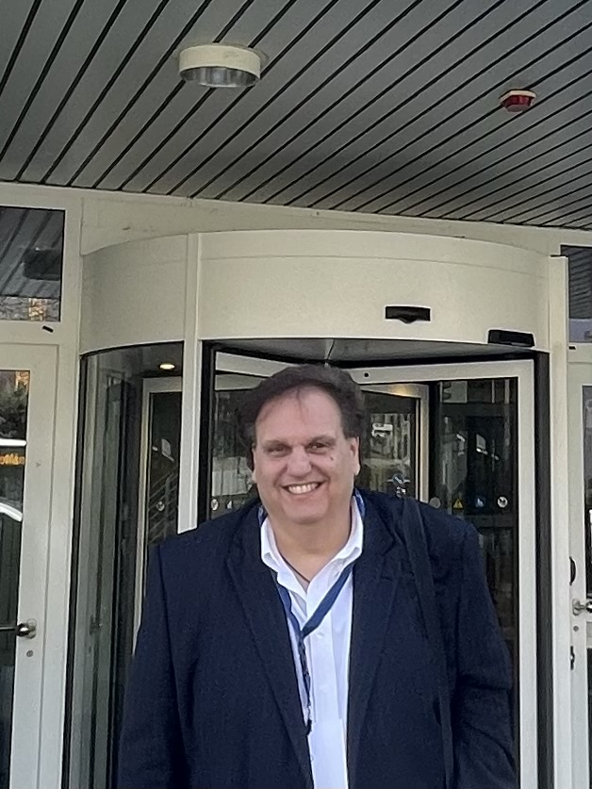
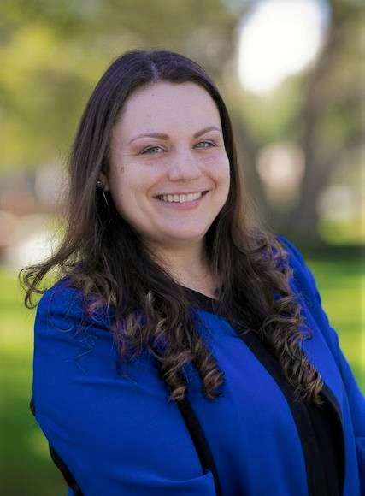
A WARM WELCOME
to our dear partners
from Florida Atlantic
University
20-24 maggio 2024
Prof Joe Compomizzi
Prof Kelly Roy
Project: 2023-1-IT01-KA121-VET-000122809

